Slide 1

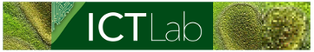


1
3
CROP/WEED ANALYSIS ON UAV IMAGES
Bachelor Internship defense
July 26, 2022
By PHAM Gia Phuc
Supervised by: Dr. TRAN Giang Son

Slide 2

TABLE OF CONTENTS
01
04
03
INTRODUCTION
RESULTS AND DISCUSSION
02
BACKGROUND
05
CONCLUSIONS
MATERIALS AND METHOD

Slide 3
01. Introduction
Agriculture
the practice of cultivating plants and livestock
key development in the rise of sedentary human civilization
Precision Agriculture
an approach to farm management
uses information technology (IT)
Notes:
Agriculture or farming is the practice of cultivating plants and livestock.^{[1]} Agriculture was the key development in the rise of sedentary human civilization, whereby farming of domesticated species created food surpluses that enabled people to live in cities
- ensure crops and soil receive exactly what they need for optimum health and productivity
- ensure rofitability, sustainability and protection of the environment

Slide 4
01. Introduction
Unmanned Aerial Vehicle (UAV)
an aircraft without any human pilot, crew, or passengers on board
a component of an Unmanned Aircraft System (UAS)
a ground-based controller
system of communications with the UAV
UAV in Agriculture
provide more up-to-date information
allowing even greater precision
Notes:
a component of an Unmanned Aircraft System (UAS) which includes adding a ground-based controller and a system of communications with the UAV
High spatial/spectral resolution
Data available all time whenever it is needed
Not sensitive to clouds
Accurate position
Difficult areas accessibility

Slide 5
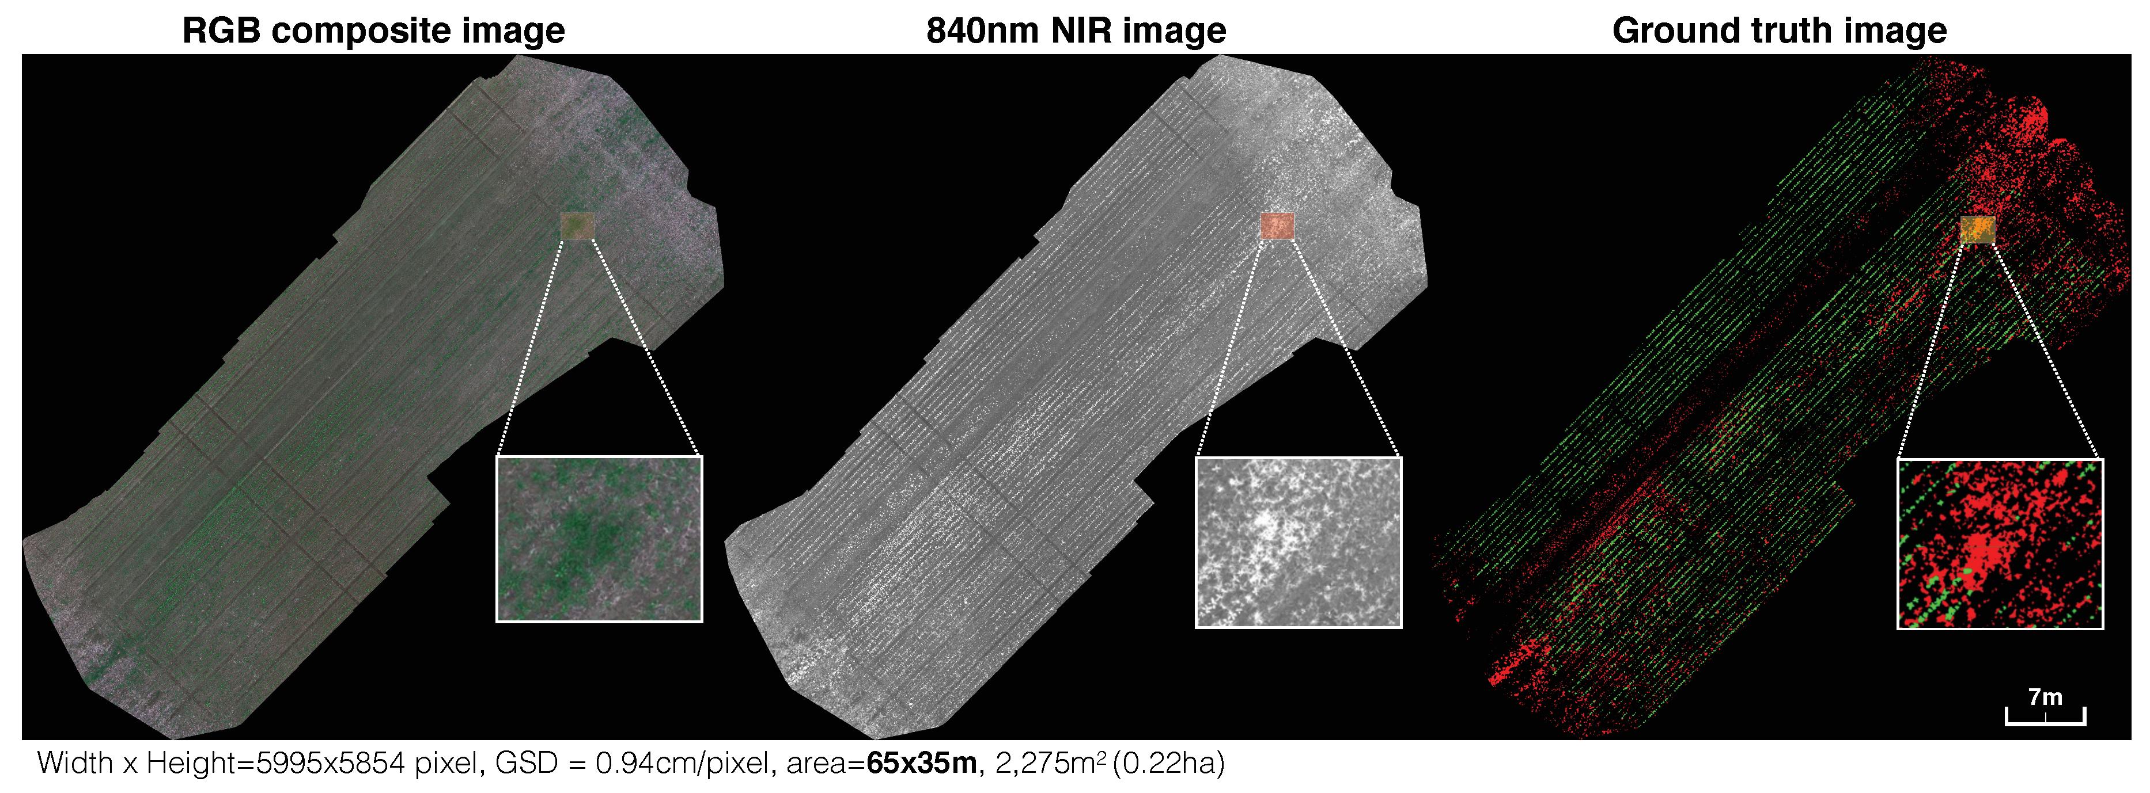
01. Introduction (bỏ)
Problem statement
UAV images captured from high position are effective in precision agriculture
Potential approach: Semantic Segmentation
Figure: An example of the orthomosaic maps

Slide 6
01. Introduction
Internship Objective
Study precision agriculture
Research in semantic segmentation
Develop a deep learning model for Weed mapping that utilizes multispectral pictures
Implemented model – able to assist scientists and farmers in deciding which algorithms to employ
accurately analyzing different crop/weed locations

Slide 7
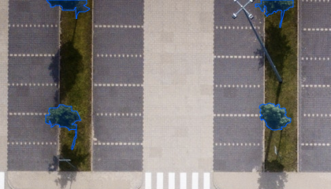
02. Background
Semantic segmentation
A Computer Vision task – specific regions of an image will be labelled
Aim to assign a class to each pixel
Corresponds to the concept being represented
dense prediction - every pixel in the image is forecasted
Precision Agriculture
Autonomous vehicles
BioMedical Image Diagnosis
Geo Sensing
Notes:
Autonomous vehicles, BioMedical Image Diagnosis, Geo Sensing, Precision Agriculture
Will be added with images after the “NOTE” disappear with animation
only considers the category of each pixel, not instances of the same class
does not automatically differentiate two objects of the same category in the input image as independent ones

Slide 8
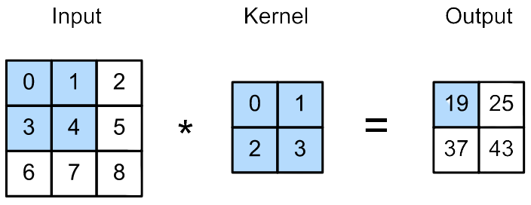
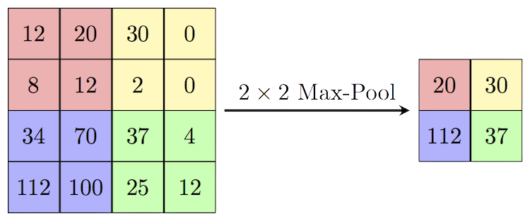
02. Background
Convolution operation
process of transforming an image
applying a kernel
Figure: Convolution operation
Max pooling operation
make the feature map smaller
eliminate unnecessary information
save only the most crucial details
arrays could be of different sizes
the dimensions should be the same for both arrays

Slide 9
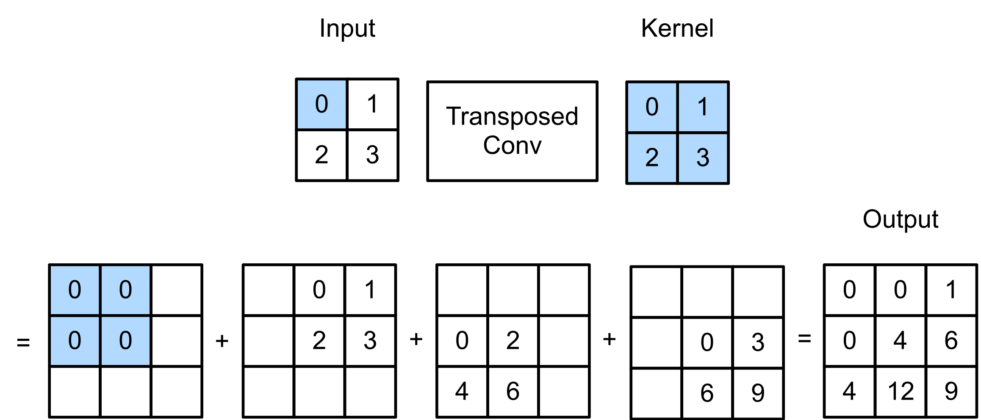
02. Background
Transposed Convolution
technique for performing up-sampling
exact reverse of a conventional convolution
input - low quality images
output - high quality images
Notes:
maximum pixel value from each 2x2 block of the input feature map is chosen to create a pooled feature map
https://d2l.ai/chapter_computer-vision/transposed-conv.html

Slide 10
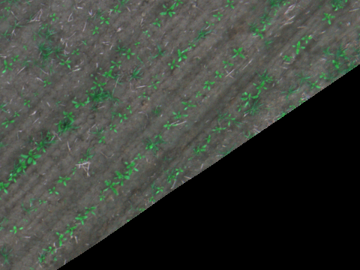

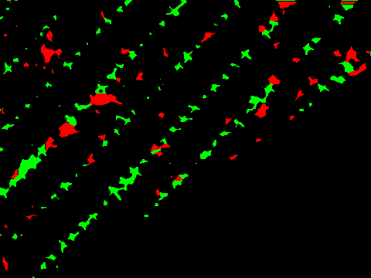
03. Materials and Methods
Data preparation
Data used filtered from original 2018 Weed Map Dataset:
Public in ASL Datasets
Divided into 129 directories and 18746 png picture file
Only RGB images, mask and groundtruth
Stored into 3 directories, 1669 files
RGB image
mask image
groundtruth image

Slide 11

03. Materials and Methods
UNet model
first introduced for biological image segmentation
tweaked and extended architecture
Allows operating with less training photos
more accurate segmentation
based on fully convolutional neural networks

Slide 12
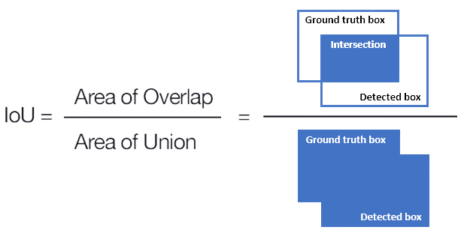
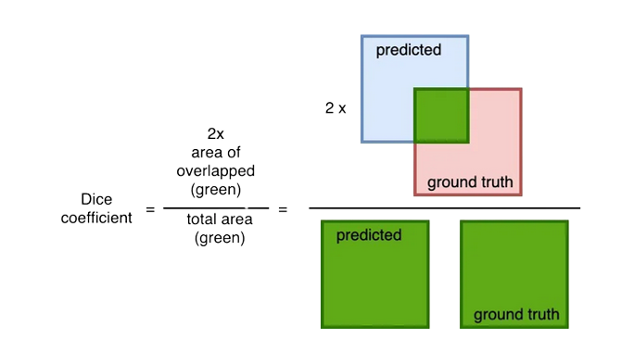
04. Results and Discussion
Evaluation metrics
Intersection over Union (Jaccard index)
an evaluation metric
measure the accuracy of an object detector
Dice Coefficient (F1 Score)
similar to the IoU
ranges from 0–1 (0–100%)
0 - no overlap
1 - perfectly overlap
Notes:
IoU is the area of overlap between the predicted segmentation and the ground truth divided by the area of union between the predicted segmentation and the ground truth.
Dice Coefficient is 2 * the Area of Overlap divided by the total number of pixels in both images

Slide 13
04. Results and Discussion (SHOuld rm?)
Training configuration
Training set: 90% data prepared
Validation set: 10% data prepared
Parameter | Value
Epochs | 100
Steps per epoch | 10
Batch size | 32
Early stopping | 10
Reduce LR on Plateau | 5
Learning rate | 10⁻³
Min learning rate | 10⁻⁵
Optimizer | Adam
Metric | IoU
 | Dice coefficient

Slide 14
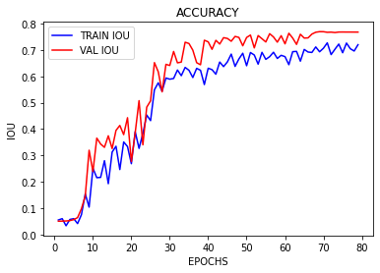
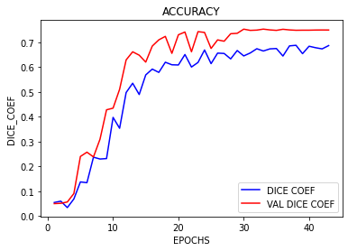
04. Results and Discussion
Effectiveness
IoU score
0.7679
Dice coefficient score
0.7495

Slide 15
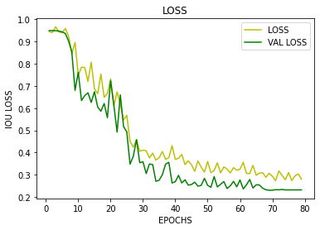
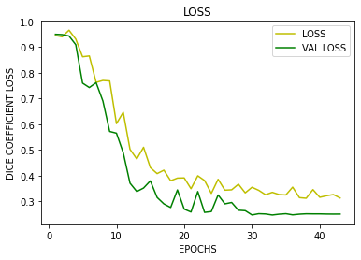
04. Results and Discussion
Loss
IoU loss
0.2863
Dice coefficient loss
0.2505

Slide 16
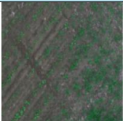
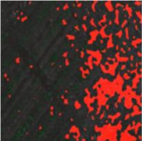
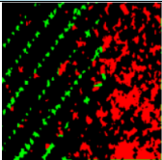
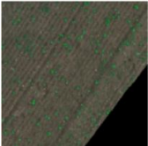
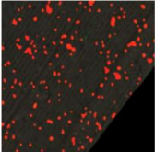
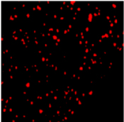
04. Results and Discussion
Model evaluation with RGB images
IoU: 0.6945
IoU: 0.7339

Slide 17
04. Results and Discussion
Comparison with existing works
Model | Device | Mean IoU | Dice Coef
The proposed Unet model | Tesla K80 | 76.79 | (waiting)
FCN-Alexnet by Jizhong et al (cite) | GTX 1060 | 70.50 | (waiting)
VGGNet-FCN by Simonyan et al | GTX 1060 | 72.80 | (waiting)
GoogLeNet-FCN by Szegedy et al | GTX 1060 | 71.30 | (waiting)
ResNet-FCN by He et al | GTX 1080 TI | 77.20 | (waiting)
Notes:
Reference in new slide

Slide 18
05. Conclusion
Complete the internship objective
Studied semantic segmentation
Research and implemented weed segmentation on UAV images
UNet segmentation model achieve ≈76% accuracy

Slide 19
05. Conclusion
Future works
Improve model performance
Implement with more datasets
Try other deep learning models
Implement both crop/weed segmentation

Slide 20

THANK YOU FOUR YOUR ATTENTION!
Please, keep this slide for attribution.

